Slide 1
Lecture 20
MATH1401
Fall 2021
Bootstrap Sampling

Slide 2
Summary – Sections 13.1-13.2
Estimate an unknown parameter
Boot Strap – How can we make conclusions about an unknown parameter based on a sample?
Confidence Intervals – How different are our estimations?

Slide 3
Percentiles

Slide 4
Computing Percentiles
The Xth percentile is first value on the sorted list that is at least as large as X% of the elements.
Example: s = [1, 7, 3, 9, 5]
Percentile Data set
s_sorted = [1, 3, 5, 7, 9]
percentile(80, s) is 7 The 80th percentile is ordered element 4: (80/100) * 5
For a percentile that does not exactly correspond to an element, take the next greater element instead

Slide 5
The percentile Function
The pth percentile is the smallest value in a set that is
at least as large as p% of the elements in the set
Function in the datascience module:
percentile(p, values)
p is between 0 and 100
Returns the pth percentile of the array
(Demo)

Slide 6
Discussion Question
Which are True, when s = [1, 7, 3, 9, 5]?
percentile(10, percentile(39, | s) s) | == == | 0 percentile(40, | s)
percentile(40, percentile(50, | s) s) | == == | percentile(41, 5 | s)
(Demo)

Slide 7
Estimation

Slide 8
Inference: Estimation
How do we calculate the value of an unknown parameter?
If you have a census (that is, the whole population):
Just calculate the parameter and you’re done
If you don’t have a census:
Take a random sample from the population
Use a statistic as an estimate of the parameter
(Demo)

Slide 9
Variability of the Estimate
One sample ➜ One estimate
But the random sample could have come out differently
And so the estimate could have been different
Big question:
How different would it be if we did it again?
(Demo)

Slide 10
Quantifying Uncertainty
The estimate is usually not exactly right:
Estimate = Parameter + Error
How accurate is the estimate, usually?
How big is a typical error?
When we have a census, we can do this by simulation
(Demo)

Slide 11
Where to Get Another Sample?
We want to understand errors of our estimate
Given the population, we could simulate
...but we only have the sample!
To get many values of the estimate, we needed many random samples
Can’t go back and sample again from the population:
No time, no money
Stuck?

Slide 12
The Bootstrap

Slide 13
The Bootstrap
A technique for simulating repeated random sampling
All that we have is the original sample
… which is large and random
Therefore, it probably resembles the population
So we sample at random from the original sample!

Slide 14
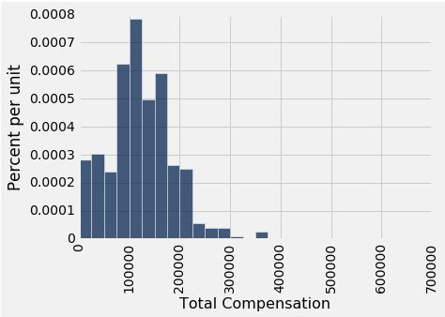
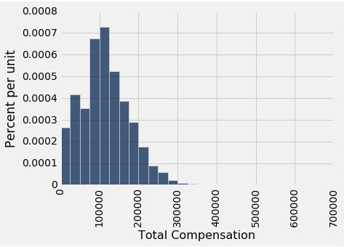
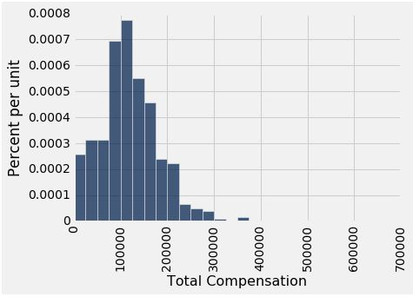
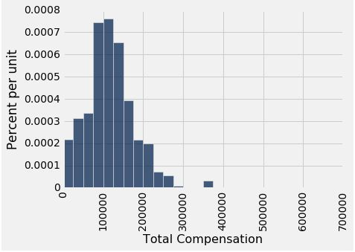
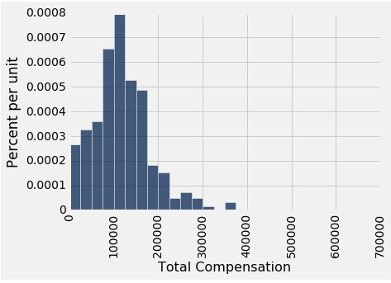

Why the Bootstrap Works
resamples
population
sample
All of these look pretty similar, most likely.

Slide 15
Why We Need the Bootstrap
resamples
population
sample
What we wish we could get
What we really get

Slide 16
Real World vs. Bootstrap World
Real world: Bootstrap world:
True probability distribution ● (population)
→ Random sample 1
→ Estimate 1
→ Random sample 2
→ Estimate 2
Empirical distribution of original sample (“population”)
→ Bootstrap sample 1
→ Estimate 1
→ Bootstrap sample 2
→ Estimate 2
…
→ Random sample 10000
→ Estimate 10000
...
→ Bootstrap sample 1000
→ Estimate 1000
Hope: these two scenarios are analogous

Slide 17
The Bootstrap Principle
The bootstrap principle:
Bootstrap-world sampling ≈ Real-world sampling
Not always true!
… but reasonable if sample is large enough
We hope that:
Variability of bootstrap estimate
Distribution of bootstrap errors
...are similar to what they are in the real world

Slide 18
Key to Resampling
From the original sample,
draw at random
with replacement
as many values as the original sample contained
The size of the new sample has to be the same as the original one, so that the two estimates are comparable
(Demo)

Slide 19
Confidence Intervals

Slide 20
95% Confidence Interval
Interval of estimates of a parameter
Based on random sampling
95% is called the confidence level
Could be any percent between 0 and 100
Higher level means wider intervals
The confidence is in the process that gives the interval:
It generates a “good” interval about 95% of the time.
(Demo)

Slide 21
Each line here is a confidence interval from a fresh sample from the population

